Slide 1
Employee Attrition Project

Slide 2
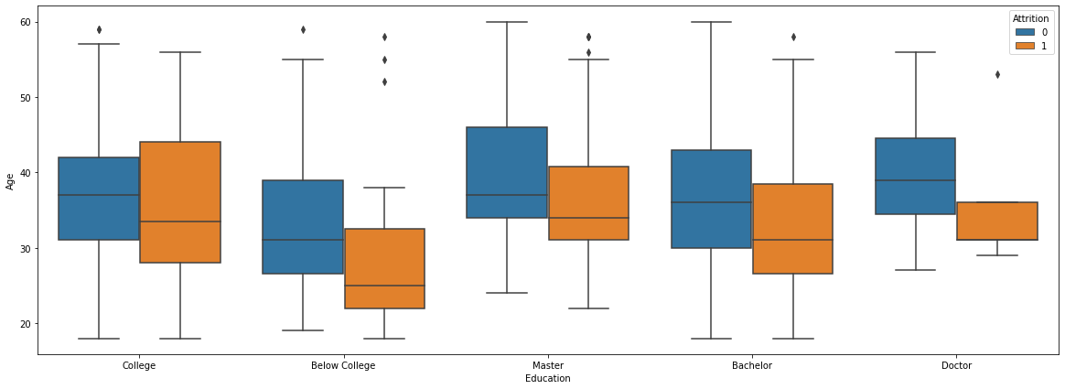
Visualization of Education and Age in respect to Attrition

Slide 3
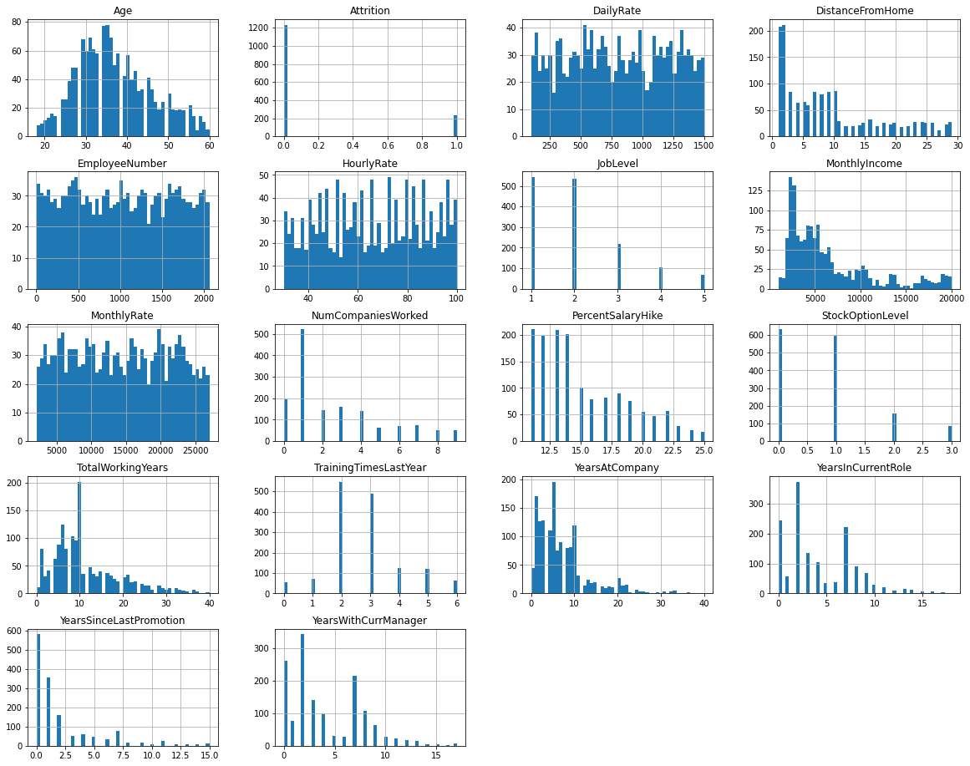
Visualizing the value distribution for each numeric column in the dataset

Slide 4
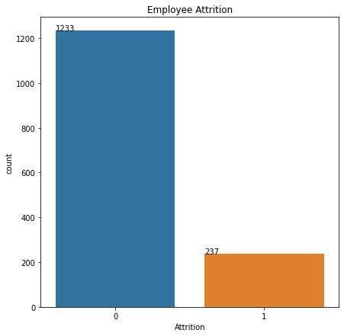
Attrition Rate
The previous percentages show that almost 84% of the employees included in the dataset did not suffer from attrition. Also, it can be observed that the data is imbalanced between the two class labels (83.8% for 'No' and 16.1% for 'Yes') of the 'Attrition' target column. Thus, there is a need to balance the sampling ratio during the training process of a classifier algorithm.

Slide 5
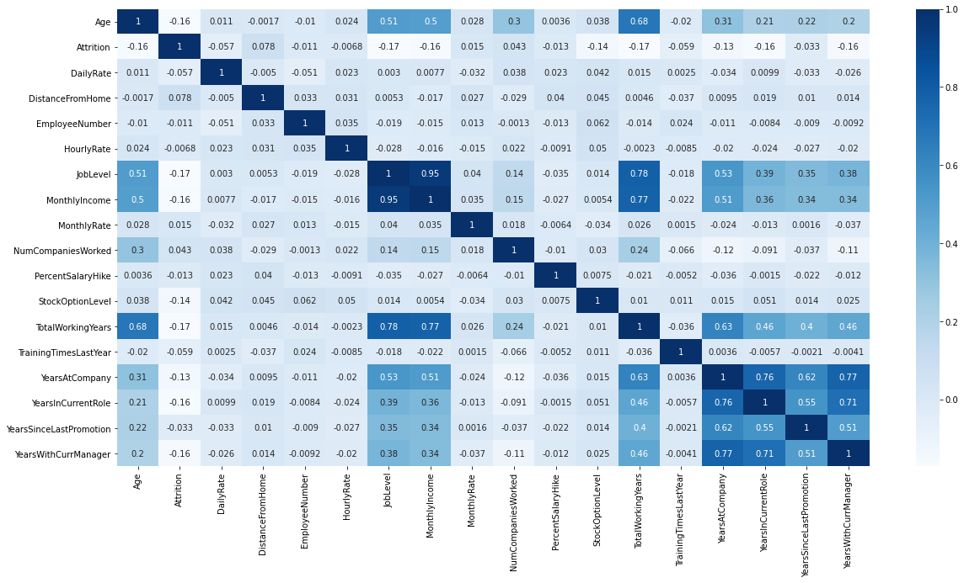
Finding correlation between variables

Slide 6
Finding correlation between variables
The correlation analysis shows interesting findings First, there is a high positive correlation between the “TotalWorkingYears” column and the “JobLevel” and “MonthlyIncome”, which reflects a sort of fairness in promoting and paying people in the company based on their experience level. Second, there was a high positive correlation between “PerformanceRating” and “PercentSalaryHike” columns, which again confirms that the increase in salary is based on the increase in the performance level. Third, the “JobSatisfaction” column does not have any correlation with the reminder of the numeric columns, which is somehow unexpected as it would be reasonable to have it increased with the increase in “MonthlyIncome” or “JobLevel” columns.

Slide 7
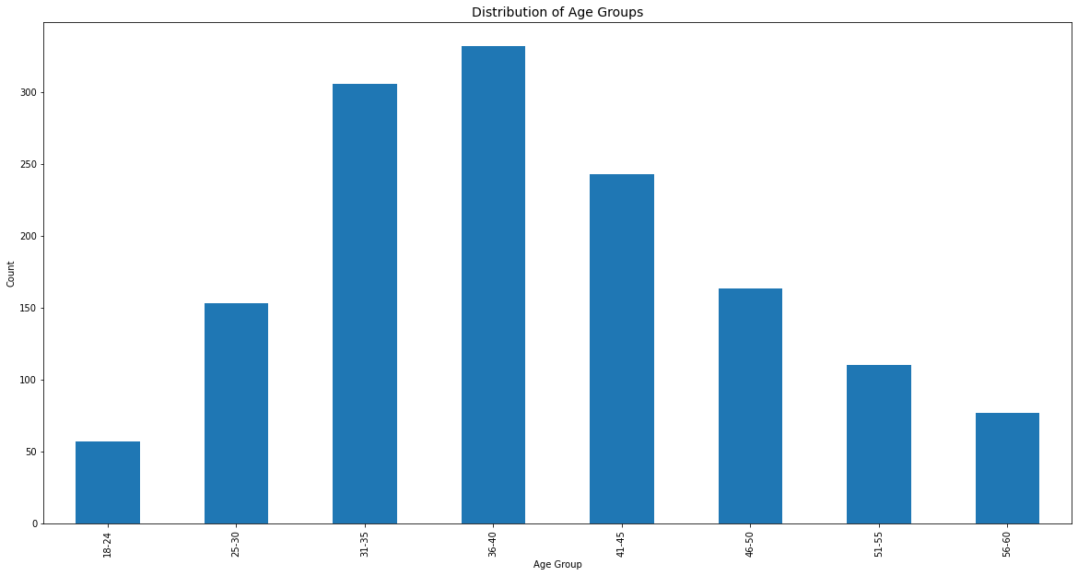
Relationship of Age Variable with Attrition

Slide 8
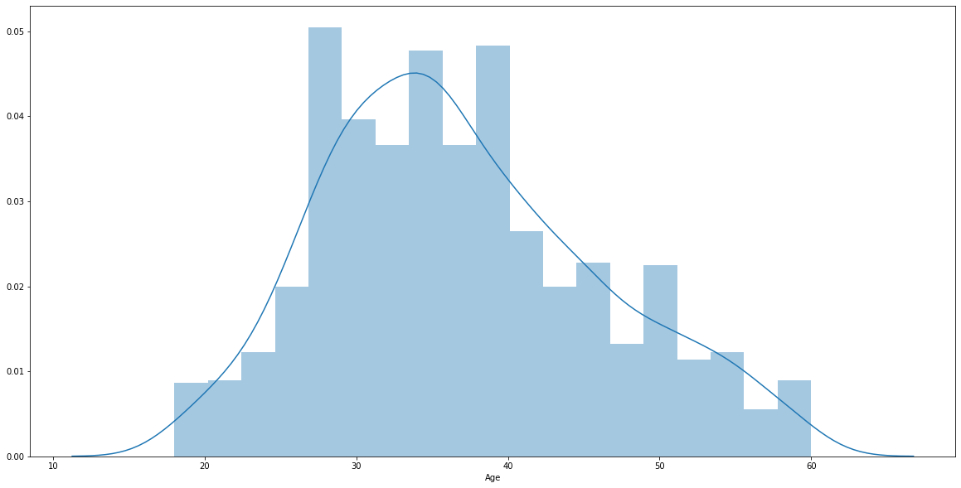
Relationship of Age Variable with Attrition

Slide 9
Relationship of Age Variable with Attrition
From the previous 2 slides, we can conclude that Attrition is the most for the age group of 35-40 and least for the ages which are just starting off or towards retirement. It is in between for the rest of the age groups. Also that the oldest employee was in his 60 years old, and he shows not attrition, while the youngest employee was in his 18, and he is attrition.

Slide 10
Inference:
We studied the dataset thoroughly and deterined which factors influence towards the attrition majorly. Factors like age have a major role where as factors like job satisfaction do not play an equally ajor role thus we can deterine by this that when an employee is most likely to have attrition and thus profit from information

